Slide 1
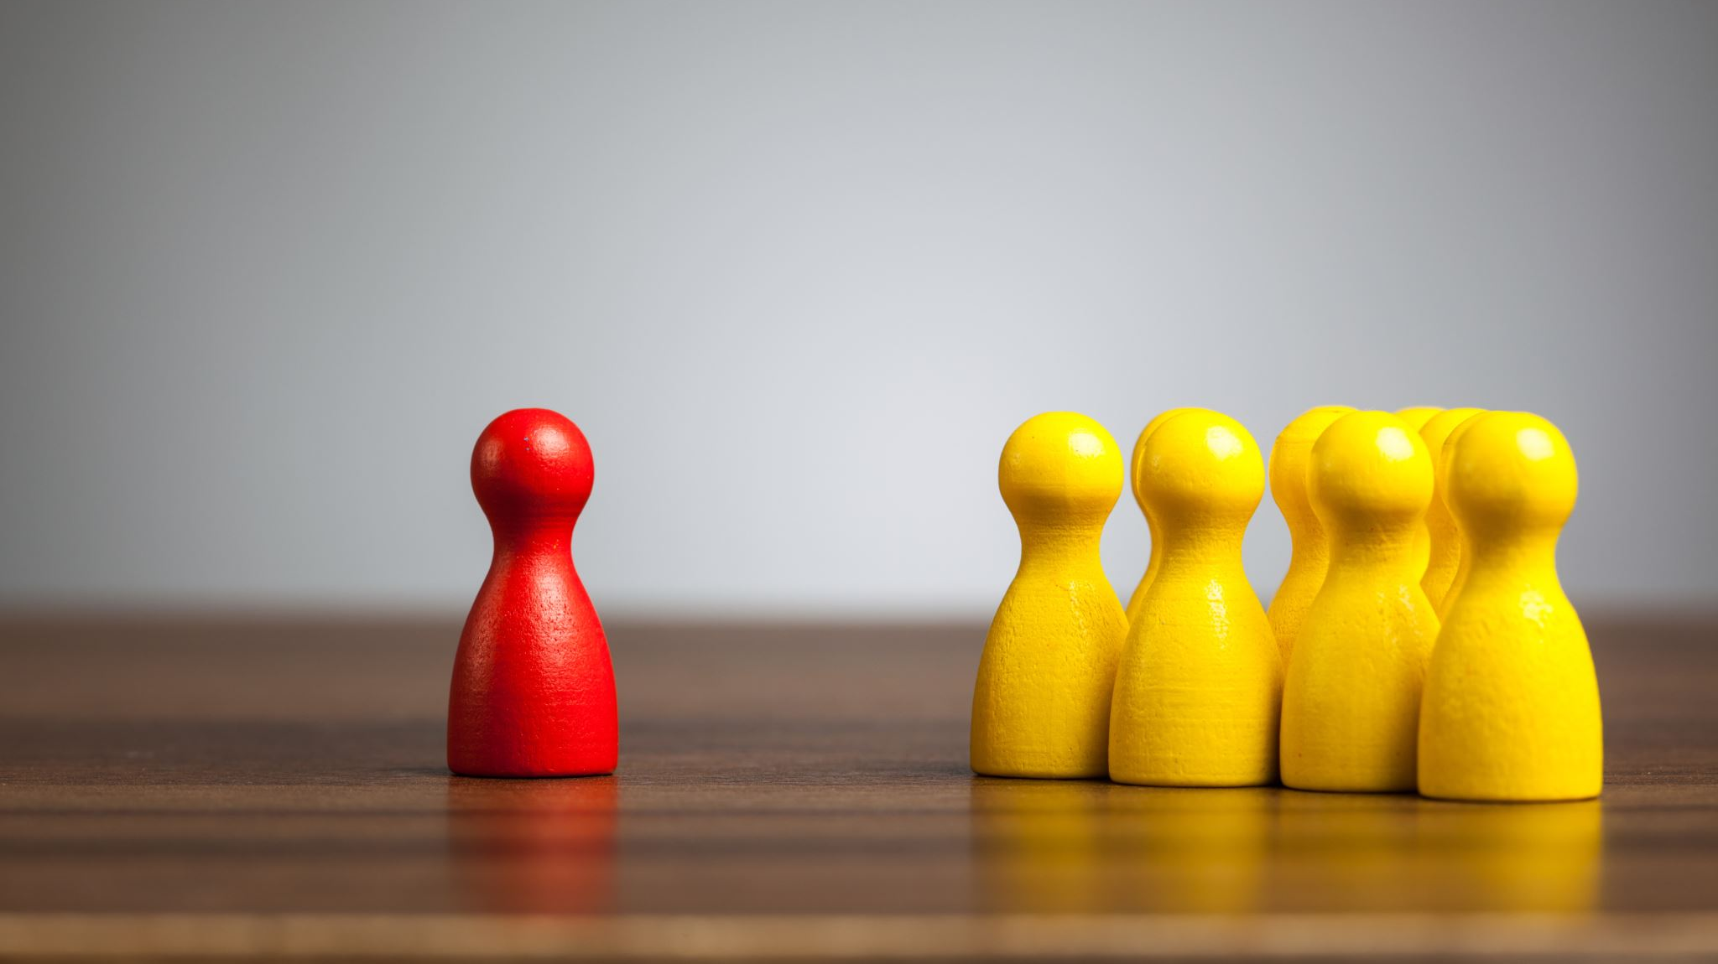
Customer Classifiers
Group 3:
Kantai Melau
Calum Knight
Adna
Nnamdi Okoroji

Slide 2
Project Overview
Maven Telecommunications are a telecom company that provides phone & internet services to more than 7000 customers in California. We have a customer churn dataset that also specifies the customer demographics amongst other information, and we are going to use this data to perform customer segmentation.
Customer segmentation is a technique used in marketing analytics. We can use machine learning to find particular clusters that share similar attributes. This would then come in handy when marketing so different customer groups can be targeted with specific marketing.

Slide 3

Data Source
A data set from Maven Analytics was used.
It has 38 columns and 7044 rows

Slide 4
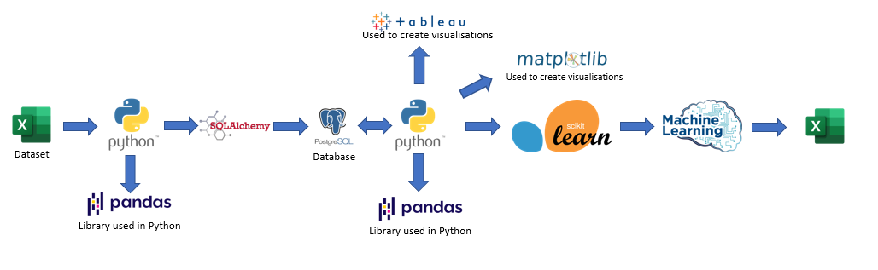
Process

Slide 5
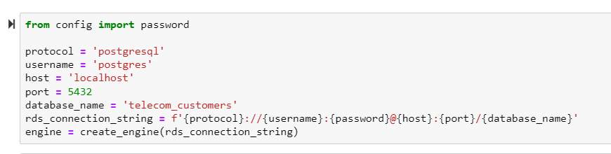
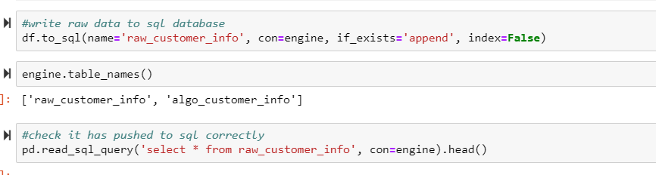
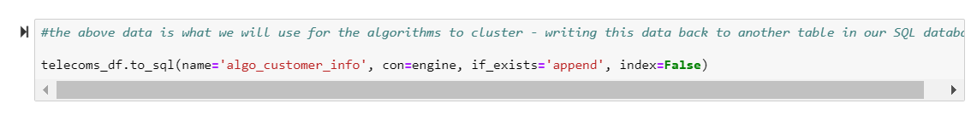
PostgreSQL
We loaded the CSV with our data into Pandas, then cleaned this raw data and wrote that to a table we created in postgresql. After this, we selected the data we wanted (dropped the columns we weren't going to use in the algorithms) and loaded this back into a different table in postgres, so that we have a copy of the data we were going to use for the machine learning algorithms.

Slide 6
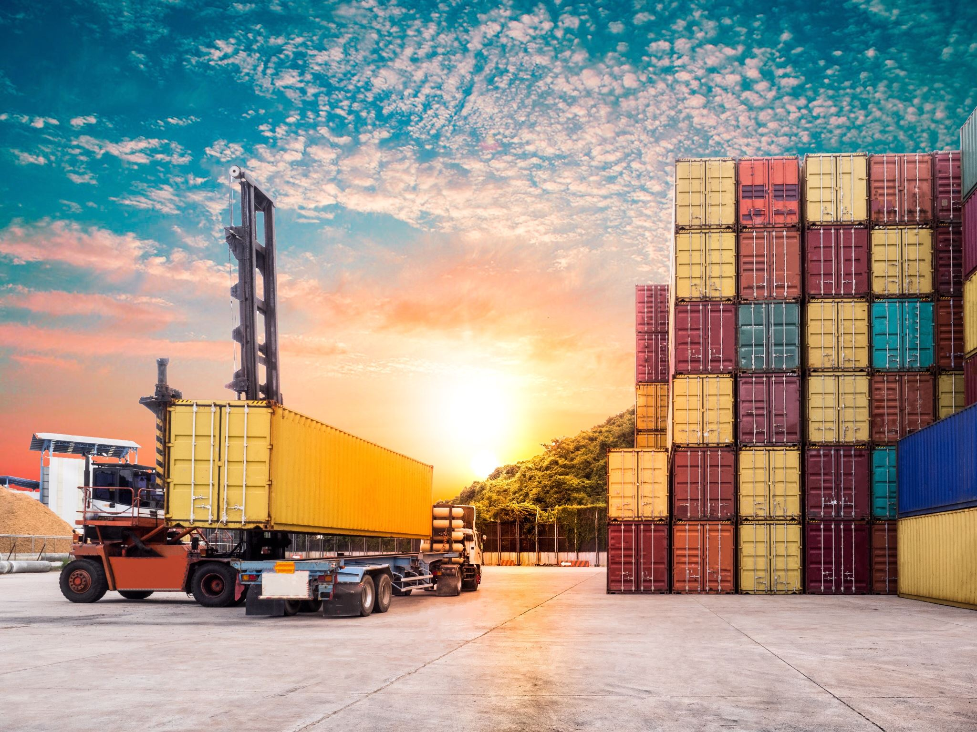
Extract, Transform & Load

Slide 7
ETL Process
EXTRACT
TRANSFORM
LOAD
Import data from CSV.
Copy it into an existing SQL database.
Read it from the database
Remove duplicates
Drop null rows
Confirm the existing columns
Drop unwanted columns
Change categorical values to numeric values
The cleansed dataset was then pushed back to the PostgreSQL Data Base for future manipulation.

Slide 8

Exploratory Data Analysis

Slide 9
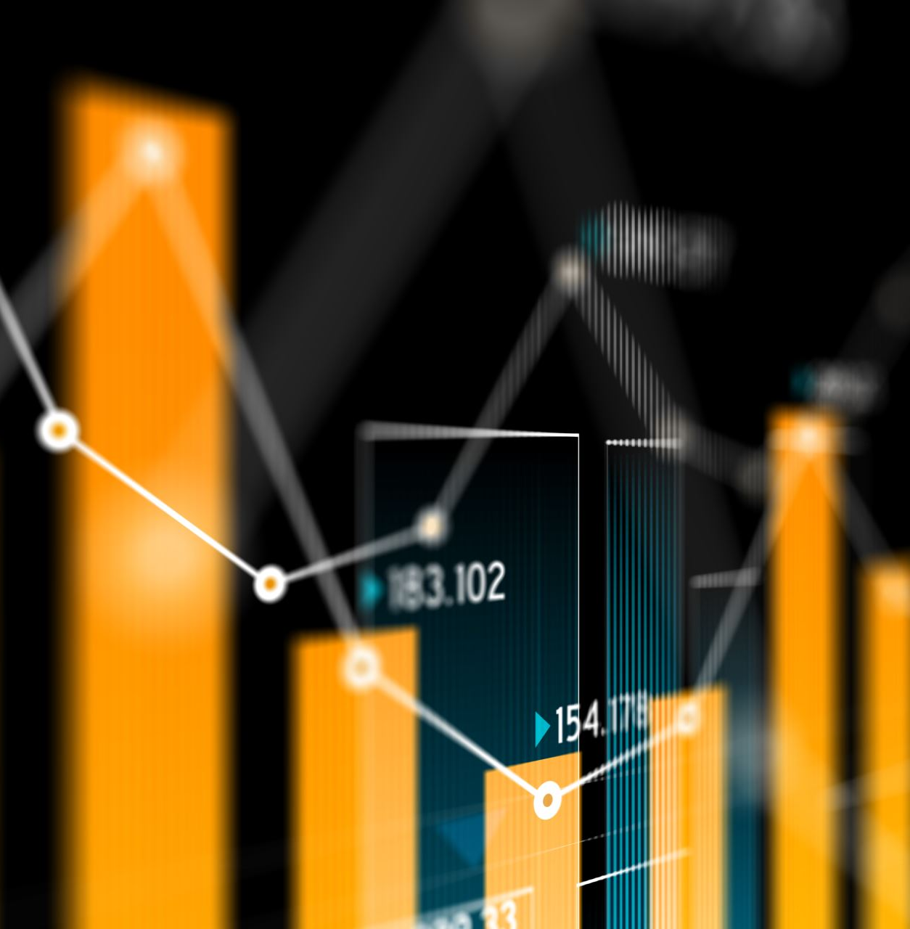
EDA
Done before Transformation of the data
Tried to identify trends that exist in the data
To identify the relevant columns
Begin to understand the dataset and its features.

Slide 10

Customer Classification

Slide 11
Unsupervised learning used to categorize the customers.
Performed 4 different explorations on the clusters:
Using both PCA and t-SNE in K-means
Using t-SNE only in K-means
Using PCA only in K-means
Using hierarchical clustering by use of a dendogram

Slide 12
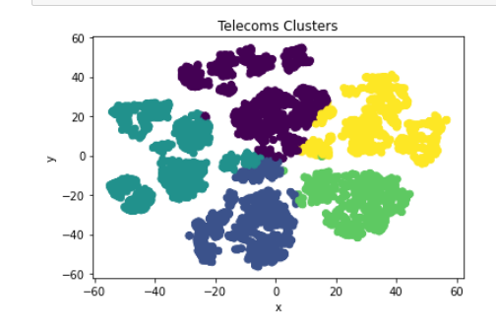
Customer Segmentation 1. Using PCA & t-SNE in K-Means

Slide 13
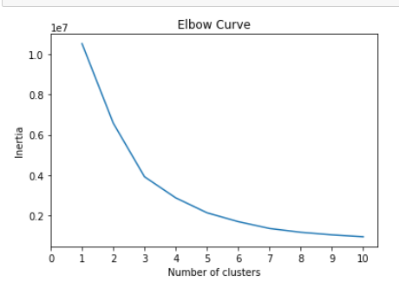
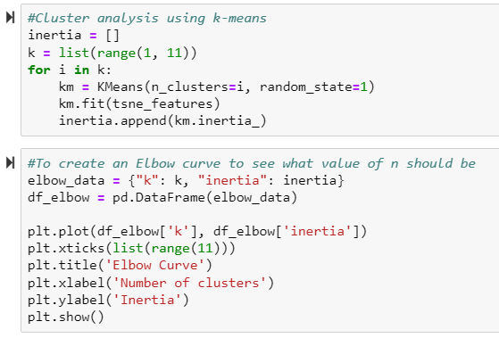
Elbow Curve
Used to determine the appropriate number of clusters in the data.
We selected 5 clusters from the shape of the curve.

Slide 14
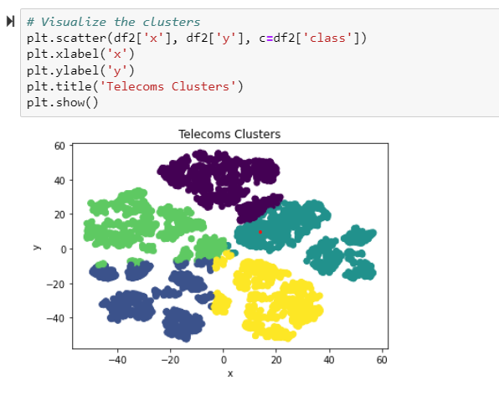
2. Using t-SNE in K-Means
t-SNE reduces the dimensions to 2 dimensions.
Clusters formed with some overlaps

Slide 15
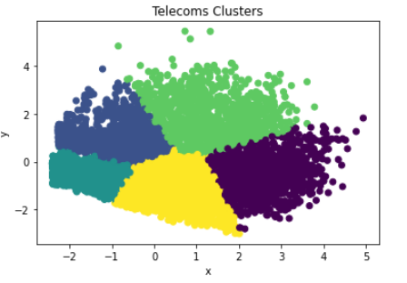
3. Using PCA in K-Means
Found most appropriate
Had clearer separation of the 3

Slide 16
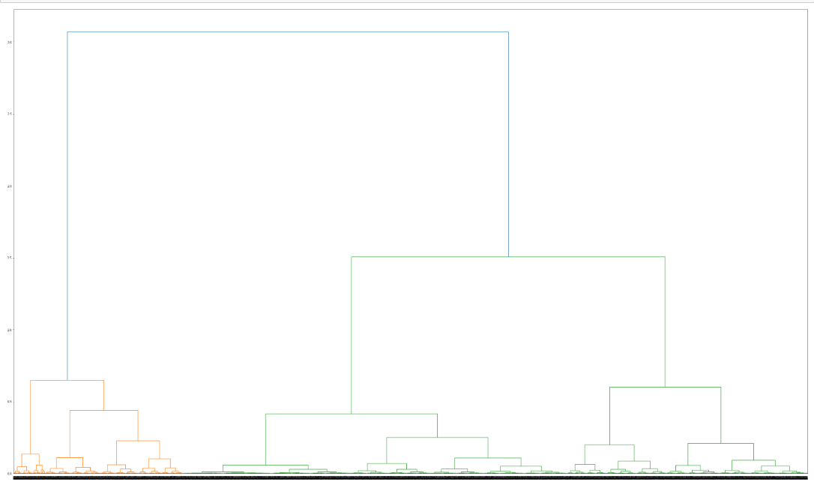
Hierarchical Classification
Tested to see the effectiveness
Clusters towards the bottom not clearly visible or identifiable
Not suitable because of the size of the data.

Slide 17
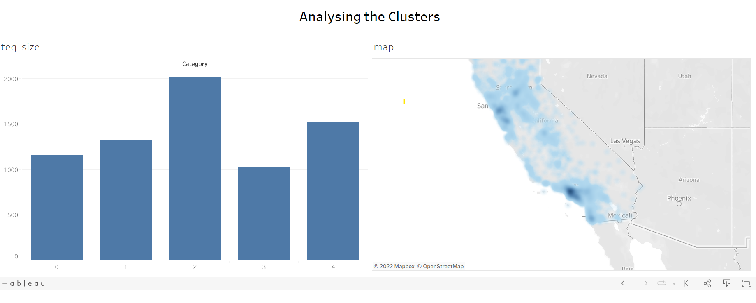
Tableau

Slide 18

Demo

Slide 19

Conclusion
PCA and K-means were found to be better at forming clusters for classification
Some clusters contained almost similar information.

Slide 20


